Slide 1




DevJams’26
Exasol Workshop & Live Demo
GDG On Campus, VIT Vellore • 29 August 2026
Copyright © 2026 Exasol. All rights reserved.
1

Slide 2

Welcome
Balajee Rajaram
Head of Exasol India
Copyright © 2026 Exasol. All rights reserved.
2

Slide 3

Workshop & Live Demo
Yuvaraj M
Product Evangelist, Exasol
Hands-on with Exasol Personal, agent-oriented analytics on your own laptop.

Slide 4
AI has changed the workload, not the infrastructure
Databases were designed for a human at the end of the query. That assumption is gone.
Built for humans
One analyst. One query. Then waits.
Knows the schema already
One query, then waits
Thirty seconds is acceptable
Built for agents
One agent. Dozens of queries at once.
Starts blind, every single time
Dozens of queries in a loop
Thirty seconds breaks the loop
Copyright © 2026 Exasol. All rights reserved.

Slide 5
What makes a database agentic
Four properties. Each one is a design choice, not a feature you can bolt on.
01 Discoverable
Finds the schema without reading it all
Human knows it → agent starts blind
02 Concurrent
Many queries at once, nothing queues
One question → dozens of round trips
03 Headless
The agent provisions it and tears it down
Today a human sets it up first
04 Governed
The database enforces what it may touch
Not the prompt, not good intentions
All four assume the same thing: the agent, not the human, is the user
Copyright © 2026 Exasol. All rights reserved.

Slide 6
Under the hood
The protocol is standard. What sits behind it is where things break.
AI agent
Claude, Copilot
MCP
Model Context Protocol
Database
Not all can keep up
One question from you becomes dozens of round trips
01 Metadata layer
Asks what exists first
Without it, it guesses table names and fails
02 Query execution
Parallel and in-memory
Without it, the loop stalls and times out
03 Deployment
Runs on your hardware
Without it, your data must leave to be useful
Copyright © 2026 Exasol. All rights reserved.

Slide 7
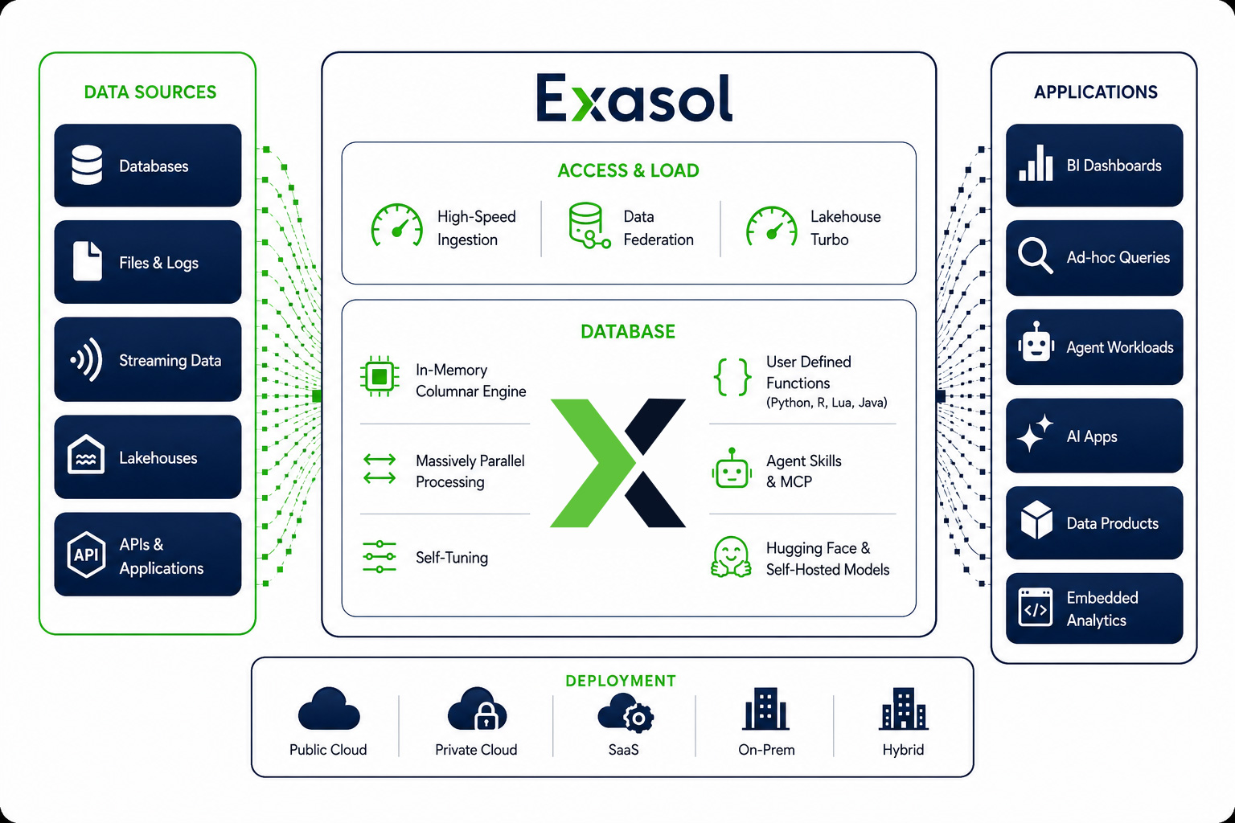
Exasol Architecture
Copyright © 2026 Exasol. All rights reserved.

Slide 8
Exasol AI key components
In-database AI
via UDFs
Python, R, Java, Lua run in-database
Automatic parallel across all nodes
No data movement, compute at source
GPU acceleration for ML workloads
MCP server
Conversational analytics
Standards-compliant gateway for agents
Automated schema and metadata lookup
Text-to-SQL for natural language
Read-only access for security and audit
SQL-native LLM
Connections
Single CREATE CONNECTION statement
Cloud and self-hosted models
No custom connectors or middleware
Swap providers with no code changes
Native agent
Architecture
Build and run agents fully within Exasol
Models, prompts, tools and memory
All operations run in-database
Zero external data movement
CREATE PYTHON3
SET SCRIPT predict()
# MIT licensed
pip install
exasol-mcp-server
CREATE CONNECTION
my_llm TO api_url
SELECT * FROM
agent_run('...')
AI executes in-database
Extending the execution foundation
Copyright © 2026 Exasol. All rights reserved.

Slide 9
Exasol Personal Local — run it in seconds
The Analytics Database for Agentic AI. Free for personal use.
One command. No cloud account. No license key.
01 One-command install
Full Exasol starter kit on your laptop in seconds
Supports macOS, Linux and Windows (WSL)
02 Full enterprise engine
The full analytics database for personal use
No features removed
03 Unlimited data
No memory, storage or compute limits
No artificial limits
04 Agent-ready by default
Built-in MCP server, drivers and AI tooling
Everything needed for AI agents is included
The only restriction is single-user. Everything else is free.
Copyright © 2026 Exasol. All rights reserved.

Slide 10
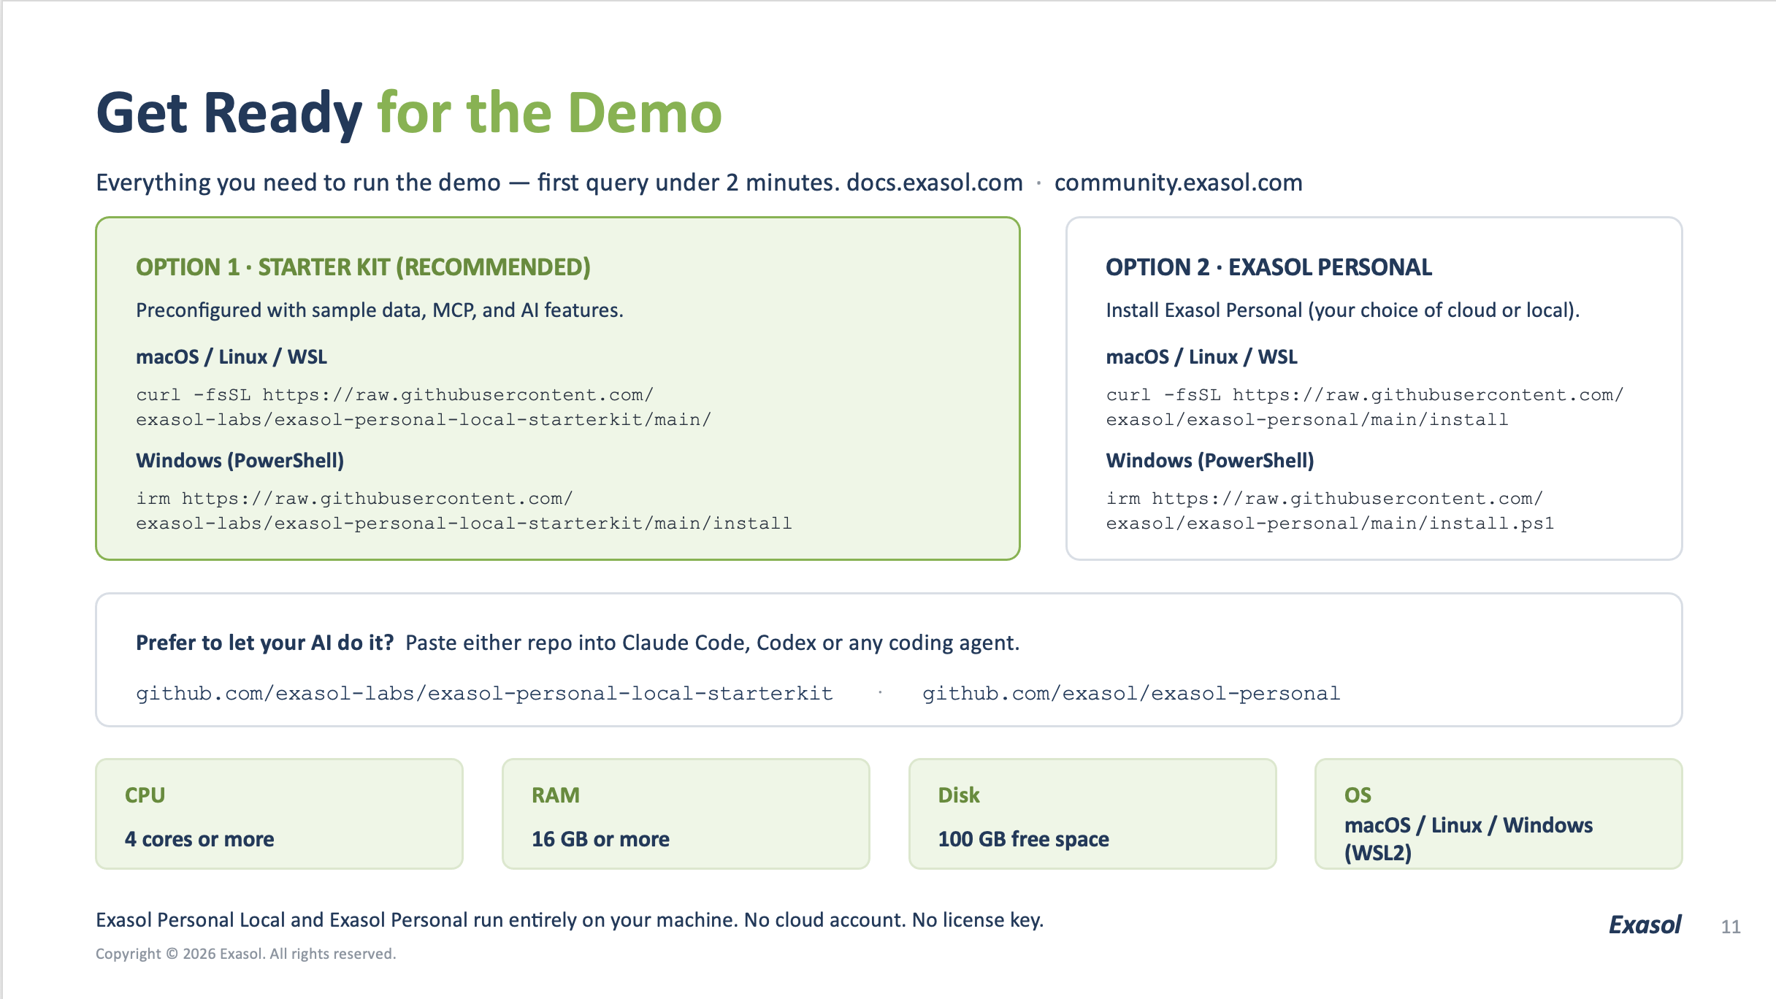

Slide 11
From question to dashboard, no human in between
dash-server is an MCP-first host that lets agents build and deploy live Dash apps against Exasol.
Agent-operated. GitOps backed. Real Python apps.
01 Agent builds it
A user asks, an agent creates the app through MCP
No manual scaffolding or deploy steps
02 Real Python apps
Full Dash and Plotly, not a fixed BI canvas
Callbacks, routing, custom logic included
03 Exasol-native
Pushes heavy aggregation into the database first
SQL does the work, not the browser
04 GitOps backed
Every revision is versioned and rollbackable
Durable history, not opaque runtime state
Not BI, automated. Analytical apps generated at the speed of prompting.
Copyright © 2026 Exasol. All rights reserved.

Slide 12
Same data – read four ways
One e-commerce orders and inventory dataset lands in the warehouse once. The CFO, sales, operations and supply
chain teams each pull a dashboard from it the same afternoon, and none of them ask an analyst to write the SQL.
01 CFO
Revenue, margin and discount impact, quarter over quarter
Gross margin trend · discount-driven revenue loss
02 Sales Manager
The full analytics database for personal use
Best sellers by region · conversion trend
03 Operations Manager
Order fulfilment speed and warehouse throughput
Pick-to-ship time · return rate by category
04 Supply chain manager
Inventory turnover and supplier lead time
Stockout risk by SKU · reorder timing
Same schema, four dashboards. No human rewriting the SQL each time.
Copyright © 2026 Exasol. All rights reserved.

Slide 13
HACKATHON · REGISTRATION OPEN
Exasol AI + Data Challenge 2026
TOTAL PRIZE POOL
₹85,000
1st ₹50,000
Build for 7 days. Win a slice of ₹85,000. Get your project judged by Exasol engineers.
2nd ₹25,000
3rd ₹10,000
Teams of 3 to 5
4 open tracks
Local, AWS or Azure
REGISTER YOUR TEAM AT
exasol.com/events/exasol-devjam
Registration closes 06 Sep, 11:59 pm IST
Registration closes
06 Sep 2026
Build window
07–13 Sep
Winners announced
21 Sep 2026

Slide 14
Pick a track. Ship something real.
AI agents that act
Multi-agent workflows
MCP-powered apps
Research & analytics agents
Workflow automation
Intelligent data apps
Conversational analytics
Natural-language BI
Recommendation engines
Data storytelling
Trust & governance
Agent guardrails
AI observability
Data lineage
Bias & risk monitoring
Predict & optimise
Fraud & anomaly detection
Demand forecasting
Predictive maintenance
Energy & mobility
The rules
Teams of 3 to 5
Exasol Personal is mandatory
Run local, on AWS or Azure
Public GitHub repo
What you submit
Repo with a clean README
Pitch deck
Demo video, max 3 min
Due 13 Sep, 11:59 pm IST
What you walk away with
A share of ₹85,000
Feedback from Exasol engineers
A portfolio-ready AI project
Winners announced 21 Sep
Any language, any framework, any LLM — register your team at exasol.com/events/exasol-devjam

Slide 15
Thank you.
Questions? Come find the Exasol team at DevJams’26.
Register: exasol.com/events/exasol-devjam
Bring the idea. Build something that matters.

